Slide 1
Design Thinking
Quietify : Noice Detecting and Alert System
Primary Research:
Batch: E-23
Group Name : MindCraft
Team Members:
1.Varad Patil (202501070193)
2.Kadambari Jawali (202501070186)
3.Parth Nasare (202501070185)
4.Pavani Kulkarni (202501070183)
Guided By:
Mrs. Nitasha Chaudhari

Slide 2
Questionnaire:
1. How often do you visit the college library?
[ A] Daily
[ B] 2-3 times a week
[C ] Once a week
[D ] Rarely
2. What is your primary reason for visiting the library?
[A ] Serious Study / Exam Prep
[B ] Casual Reading
[ C] Group Projects / Discussion
[D ] Just to relax

Slide 3
3. How often do you find the library too noisy for studying?
[A ] Always
[ B] Often
[C ] Sometimes
[D ] Rarely / Never
4. Does sudden noise (talking, phone ringing, whispering) disturb your concentration?
[A ] Yes, it breaks my focus immediately.
[ B] No, I can ignore it.

Slide 4
5. Which source of noise annoys you the most?
[A ] Students whispering/talking
[B ] Chair dragging / Footsteps
[C ] Phone notifications
[D ] Outside noise (corridor/traffic)
6. Do you think the current method (librarians saying "Shh") is effective?
[A ] Yes, it works well.
[B ] No, it only works for a short time.
[C ] No, librarians are not always around.

Slide 5
7. Would you prefer a "Silent Visual Alert" (like a red light) instead of someone verbally scolding students to be quiet?
[A ] Yes, that’s better.
[B ] No, I prefer verbal warnings.
[C ] Maybe.
8. If there was a device on the table that turned RED when noise levels got too high, would it help you be more conscious of your own volume?
[A ] Yes, definitely.
[ B] Maybe.
[C ] No, I wouldn't care.
9. ( Any other suggestions to improve library silence?
Short Answer Text _______________

Slide 6
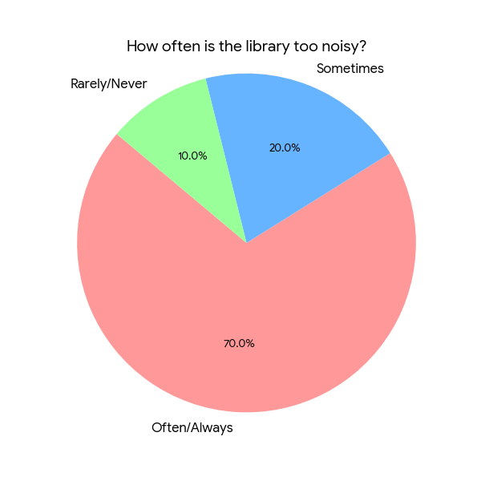
Current Status of Library Noise
Analysis of Noise Frequency Question Asked: "How often do you find the library too noisy for studying?"
Key Findings:
70% of students reported that the library is "Often" or "Always" noisy.
Only 10% feel the library is consistently quiet.
Inference: The current manual rules are not effective, leading to frequent disturbances.

Slide 7
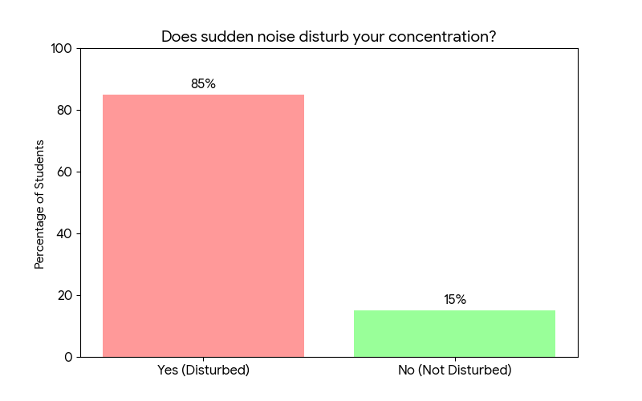
The Impact on Students:
Impact on Concentration Question Asked: "Does sudden noise or talking disturb your concentration?"
Key Findings:
85% of respondents stated they are highly disturbed by noise.
Noise is identified as the primary reason for lack of focus.
Inference: There is a critical need to reduce noise to improve study productivity.

Slide 8
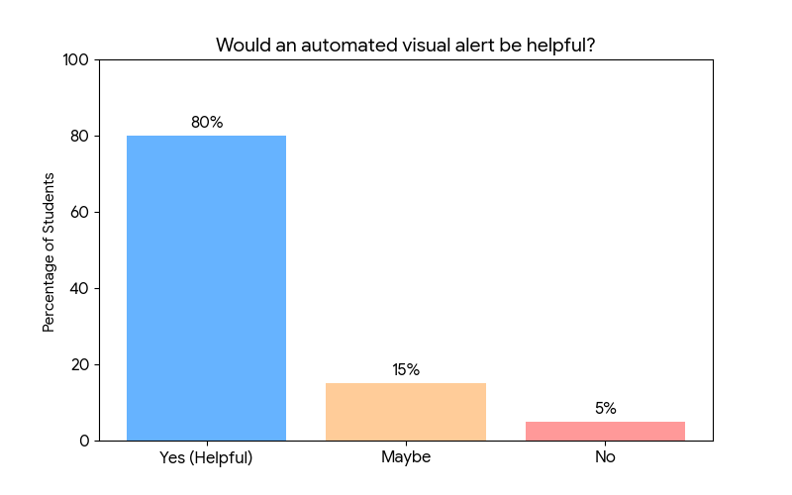
Validation of Solution:
Student Acceptance of Noise Detector Question Asked: "Would an automated visual alert be helpful to maintain silence?"
Key Findings:
80% of students agreed that a visual alert (light) would be helpful.
Students prefer an unbiased, automated system over manual warnings.
Conclusion: The survey results validate the need for the Library Noise Detector project.

